Slide 1
CS112: Introduction to Python programming
Week 15: Basic statistics and clustering in Python

Slide 2

Basic statistics in Python
Packages:
Pandas, Numpy, Scipy, …
https://scipy.org/

Slide 3
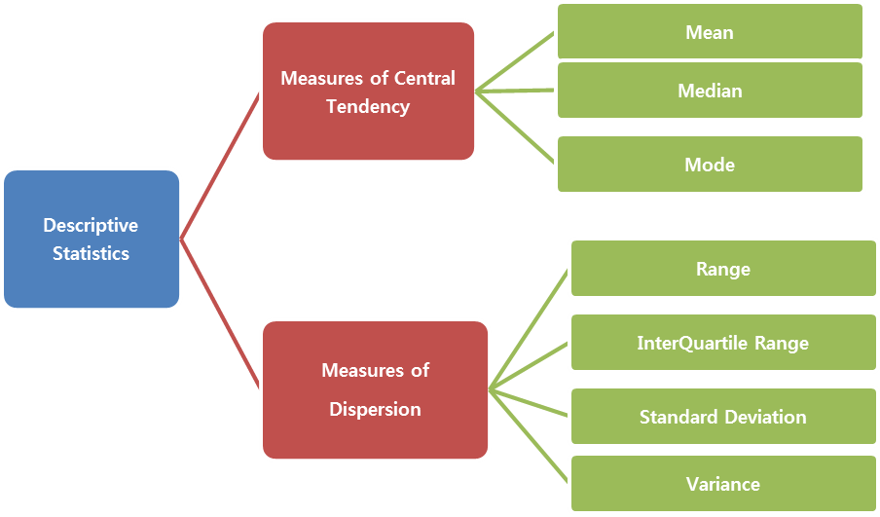
Descriptive statistics in Python

Slide 4
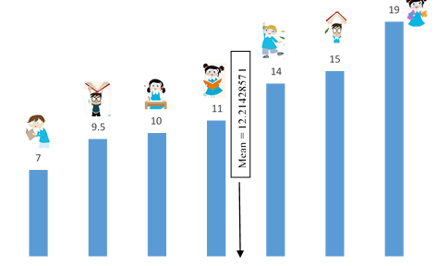
Descriptive statistics in Python
Measures of Central Tendency: Mean
The average value of a data set

Slide 5
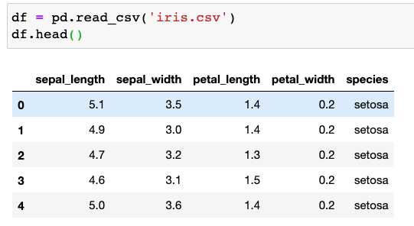
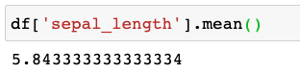
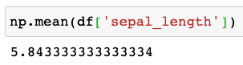
Descriptive statistics in Python
Measures of Central Tendency: Mean
The average value of a data set
pandas.DataFrame.mean()
numpy.mean()

Slide 6
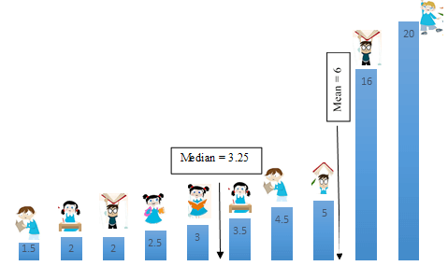
Descriptive statistics in Python
Measures of Central Tendency: Median
The middle value of a data set

Slide 7
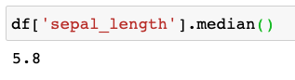
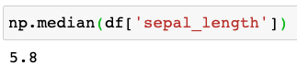
Descriptive statistics in Python
Measures of Central Tendency: Median
The middle value of a data set
The median is a better choice than mean when the indicator can be affected by some outliers.
The mean is a better choice when there are no extreme values that can affect it. It is a better summary because the information from every observation is included rather than median, which is just the middle value.
pandas.DataFrame.median()
numpy.median()

Slide 8
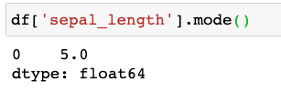
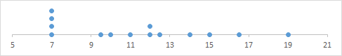
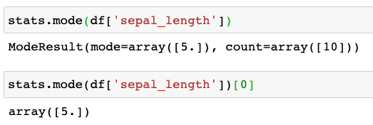
Descriptive statistics in Python
Measures of Central Tendency: Mode
The value that occurs the most number of times in the data set
pandas.DataFrame.mode()
scipy.stats.mode()

Slide 9
Descriptive statistics in Python

Slide 10
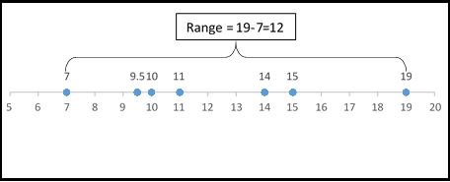
Descriptive statistics in Python
Measures of Dispersion: Range
Difference between the maximum and minimum values
The range is very sensitive to extreme values as it is the difference between the maximum and minimum values

Slide 11
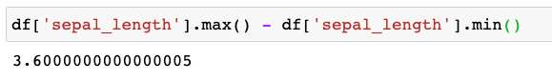
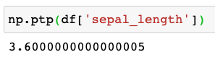
Descriptive statistics in Python
Measures of Dispersion: Range
Difference between the maximum and minimum values
pandas.DataFrame.max() , min()
numpy.ptp()

Slide 12
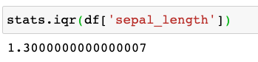
Descriptive statistics in Python
Measures of Dispersion: Interquartile Range(IQR )四分位距
The difference between the third quartile and the first quartile.
The interquartile range is a better option than range because it is not affected by outliers.
numpy.quantile ()
scipy.stats.iqr()

Slide 13
Descriptive statistics in Python
Measures of Dispersion: Standard deviation 标准差
The standard deviation summarizes how much your data differs from the mean

Slide 14
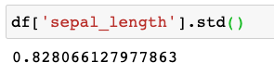
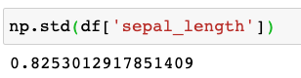
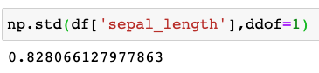
Descriptive statistics in Python
Measures of Dispersion: Standard deviation
pandas.DataFrame.std()
numpy.std()

Slide 15
Descriptive statistics in Python
Measures of Dispersion: Variance 方差
Variance is the square of the standard deviation

Slide 16
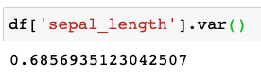
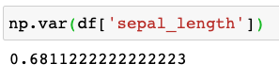
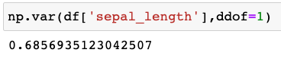
Descriptive statistics in Python
Measures of Dispersion: Variance
Variance is the square of the standard deviation
pandas.DataFrame.var()
numpy.var()

Slide 17
Inferential statistics in Python
While descriptive statistics summarize the characteristics of a data set, inferential statistics help you come to conclusions and make predictions for the larger population based on your data.
Inferential statistics have two main uses:
Making estimates about populations (for example, the mean CET-4 score of all students in China).
Testing hypotheses to draw conclusions about populations (for example, to test if CET-4 scores are significantly different between two populations).

Slide 18
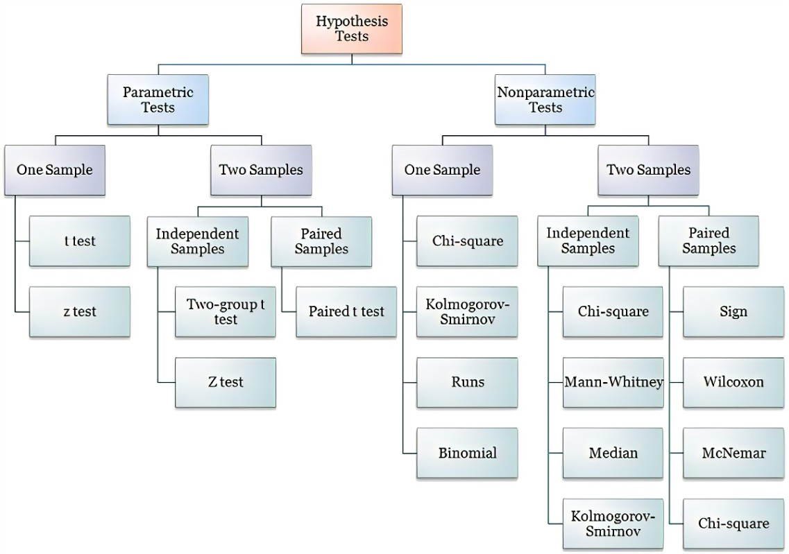
Hypothesis tests
The parametric test relies on statistical distributions in data whereas nonparametric do not depend on any distribution.

Slide 19
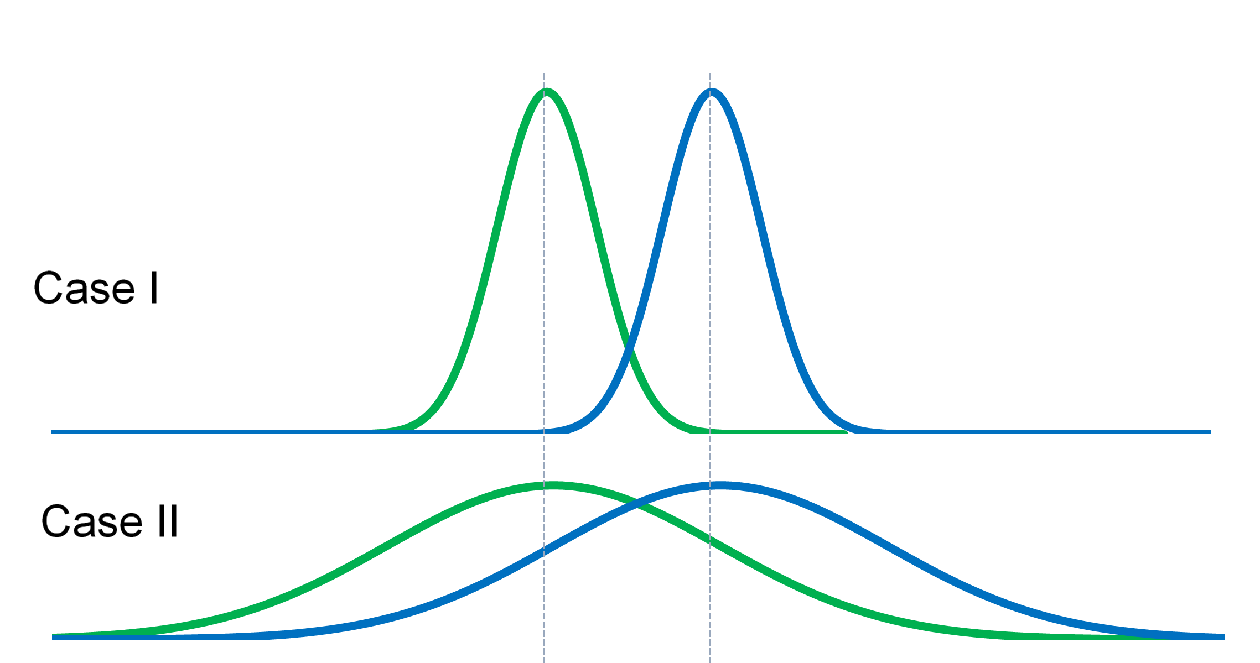
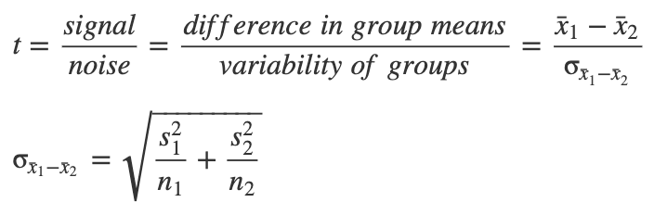
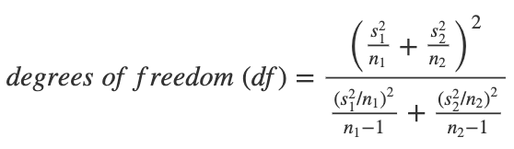
T-test
The t-test is a test to statistically determine whether the means of two normally distributed groups are different.
The p-value is obtained from the t-distribution table by looking for the t-value in the row for degrees of freedom = df.

Slide 20
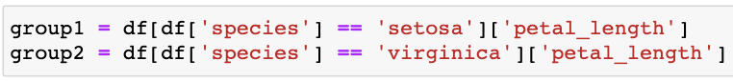
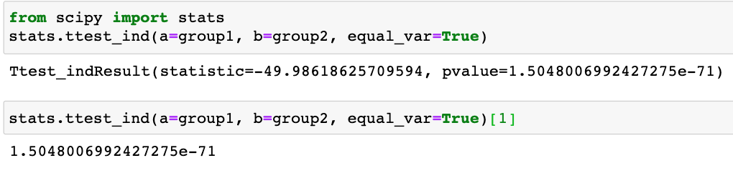
T-test in Python
scipy.stats.ttest_ind()

Slide 21
Paired t-test
A paired t-test is used to compare two population means where you have two samples in which observations in one sample can be paired with observations in the other sample.
Examples:
Before-and-after observations on the same subjects. (Responses before and after drug treatment of the same animal)
A comparison of two different methods of measurement. (blood pressure measurements in different ways )
scipy.stats.ttest_rel(a, b)
Calculate the t-test on TWO RELATED samples of scores, a and b.

Slide 22
Mann-Whitney U Test
A Mann-Whitney U test (sometimes called the Wilcoxon rank-sum test) is a non-parametric test used to compare the differences between two independent samples without making the assumption that values are normally distributed
It is considered to be the nonparametric equivalent to the two sample t-test.
…
3
2
1
rank
Rank Sum

Slide 23
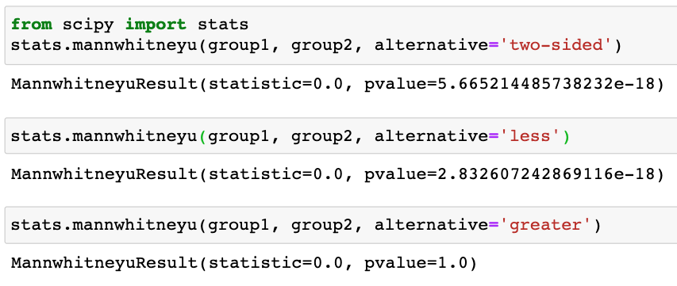
Mann-Whitney U Test in Python
scipy.stats. mannwhitneyu()
group1 > group2
Or group1 < group2
group1 < group2
group1 > group2

Slide 24
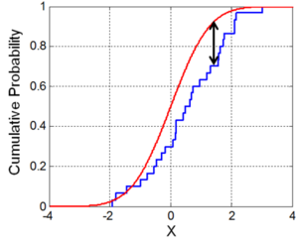
Two-Sample Kolmogorov-Smirnov Test
The two-sample Kolmogorov-Smirnov test is is a non-parametric test used to test whether two samples come from the same distribution.

Slide 25
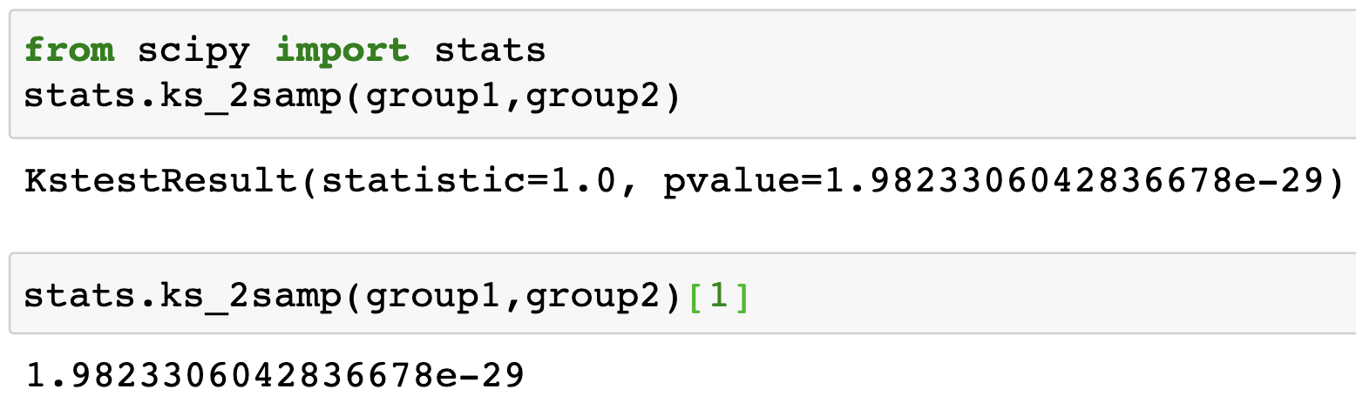
Two-Sample Kolmogorov-Smirnov Test in Python
scipy.stats.ks_2samp()

Slide 26
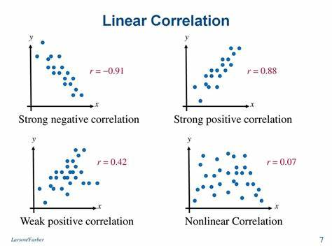
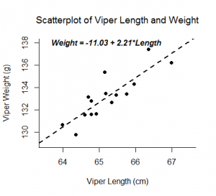
Correlation and simple linear regression
A correlation or simple linear regression analysis can determine if two numeric variables are significantly linearly related.
A correlation analysis provides information on the strength and direction of the linear relationship between two variables, while a simple linear regression analysis estimates parameters in a linear equation that can be used to predict values of one variable based on the other.

Slide 27
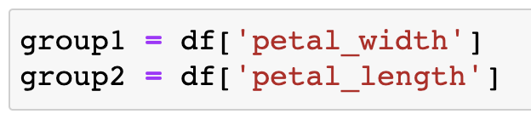
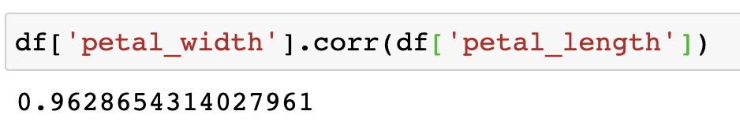
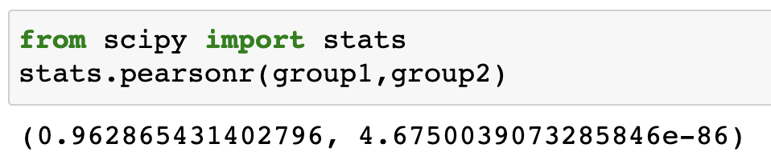
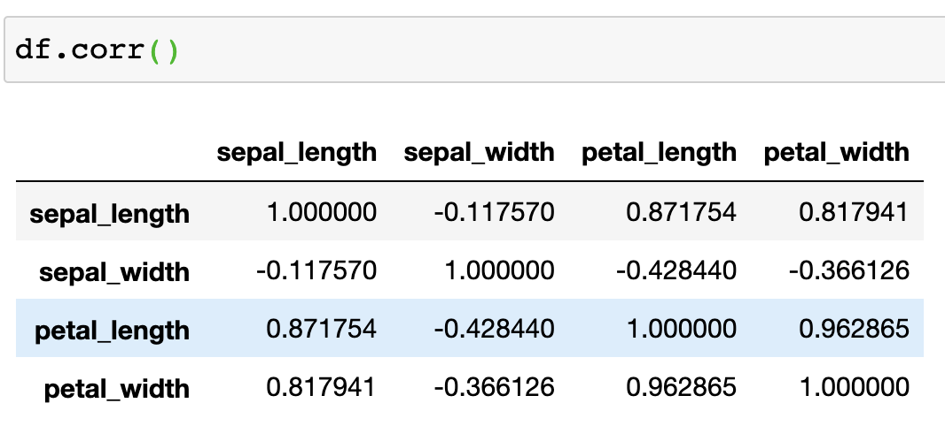
Calculate Correlation in Python
pandas.DataFrame.corr()
scipy.stats.pearsonr()
correlation coefficient
two-tailed p-value

Slide 28
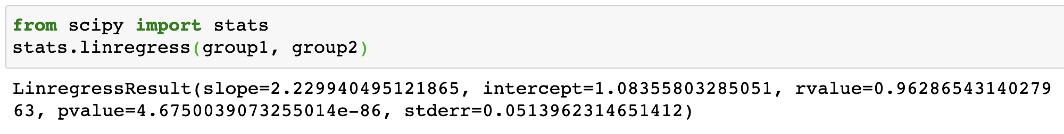
Simple linear regression in Python
scipy.stats.linregress()

Slide 29
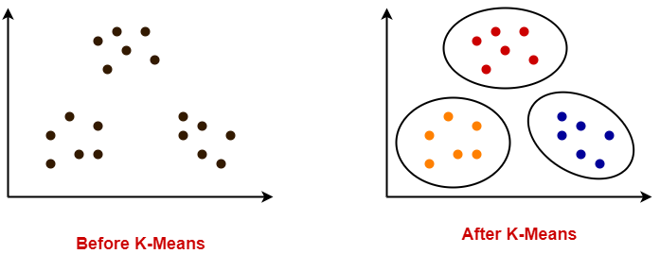
Clustering 聚类
clustering is the task of grouping a set of objects in such a way that objects in the same group (called a cluster) are more similar (in some sense or another) to each other than to those in other groups (clusters).
Good clustering:
High intra-cluster similarity
Low inter-cluster similarity

Slide 30
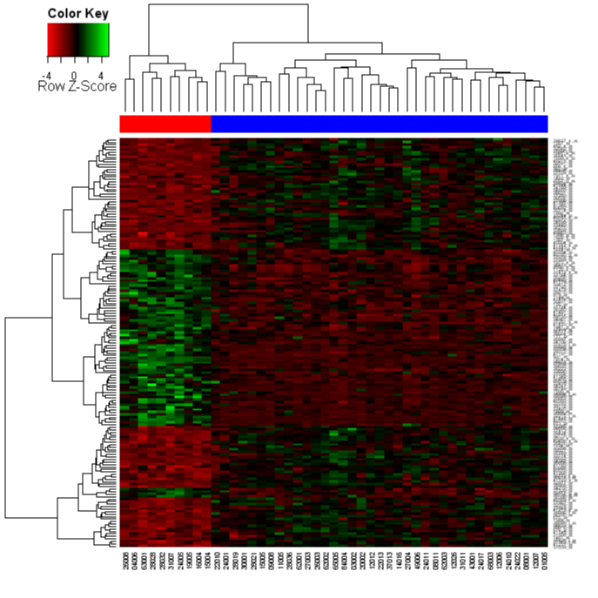
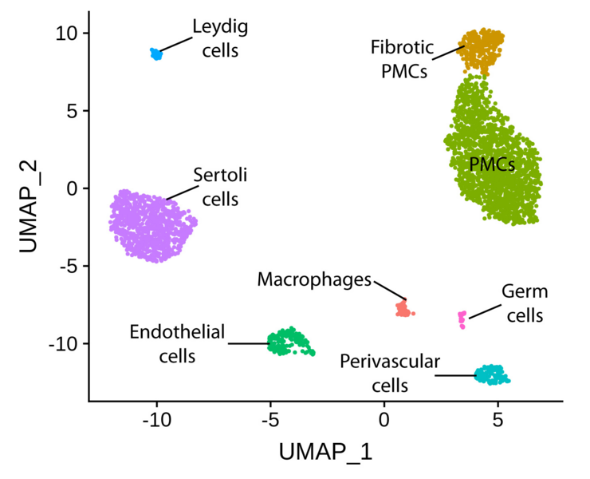
Clustering in biomedical research
Functional relationships of genes/proteins in a biological process
genes with similar functions exhibit similar expression patterns (they are co-expressed together)
Identify groups of cells / conditions
…

Slide 31
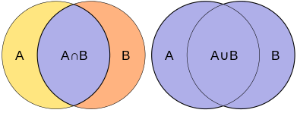
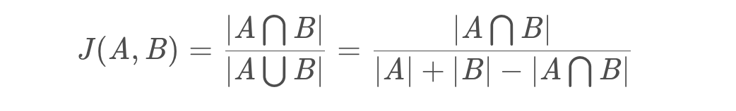
How to measure similarity
similarity: larger number means more similar
distance: larger number means less similar (zero means identical)
Jaccard similarity

Slide 32
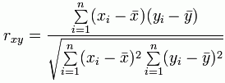
How to measure similarity
similarity: larger number means more similar
distance: larger number means less similar (zero means identical)
correlation

Slide 33
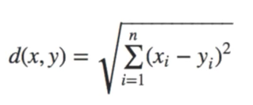
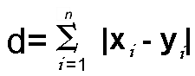
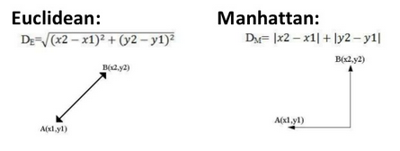
How to measure similarity
similarity: larger number means more similar
distance: larger number means less similar (zero means identical)
Euclidean distance & Manhattan distance

Slide 34
Clustering methods--K-Means
A very popular point assignment-based clustering algorithm
Goal: Group a set of points into k clusters, such that points within a cluster are closer to each other than point from different clusters.
Distance measure is typically Euclidean

Slide 35
K-Means
Input:
A set of points in m dimensions
The desired number of clusters K
Output:
A mapping from points to clusters

Slide 36
K-Means
General algorithm
Initialize K random centroids (cluster center).
You could pick K random data points and make those your starting points.
Otherwise, you pick K random values for each variable.
For every data point, look at which centroid is nearest to it.
Using some sort of measurement like Euclidean distance.
Assign the data points to the nearest centroid.
For every centroid, move the centroid to the average of the points assigned to that centroid.
Repeat the last three steps until the centroid assignment no longer changes.
The algorithm is said to have “converged” once there are no more changes.

Slide 37
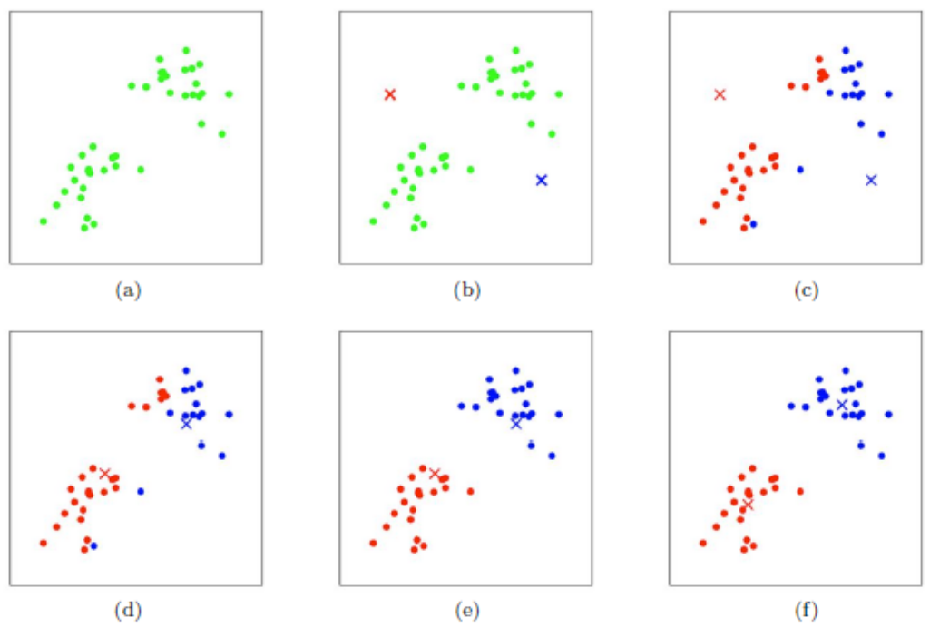
K-Means
General algorithm
– Initialize K random centroids (cluster center).
– Assign the data points to the nearest centroid
– For every centroid, move the centroid to the average of the points assigned to that centroid.
– Repeat until convergence

Slide 38
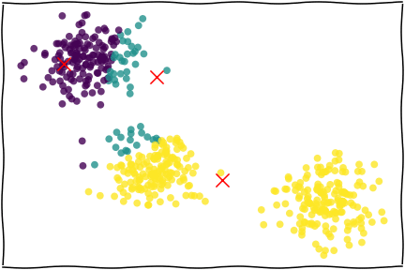
K-Means

Slide 39
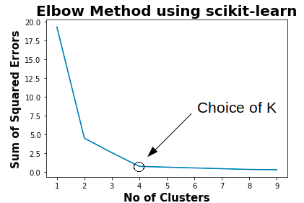
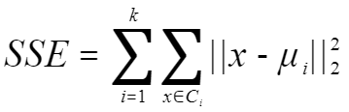
How to choose K for K-Means
The elbow method
Elbow method is one of the most popular method used to select the optimal number of clusters by fitting the model with a range of values for K in K-means algorithm. Elbow method requires drawing a line plot between SSE (Sum of Squared errors) vs number of clusters and finding the point representing the “elbow point”

Slide 40

K-Means

Slide 41


K-Means clustering in Python
scikit-learn
https://scikit-learn.org/stable/index.html
Install:
conda install -c conda-forge scikit-learn
https://scikit-learn.org/stable/modules/clustering.html#k-means
https://scikit-learn.org/stable/modules/clustering.html#clustering

Slide 42
K-Means clustering in Python
sklearn.cluster.KMeans(init=’random’, n_clusters=8, n_init=10, random_state=None)
init: Controls the initialization technique.
n_clusters: The number of clusters to place observations in.
n_init: The number of initializations to perform. The default is to run the k-means algorithm 10 times and return the one with the lowest SSE.
random_state: An integer value you can pick to make the results of the algorithm reproducible.

Slide 43

K-Means clustering in Python

Slide 44


K-Means clustering in Python

Slide 45



K-Means clustering in Python

Slide 46


K-Means clustering in Python

Slide 47

K-Means clustering in Python
Determine the optimal K using the elbow method

Slide 48
Principal component analysis (PCA)
Converts data from high dimensional space to low dimensional space by selecting the most important attributes that capture maximum information about the dataset.
https://scikit-learn.org/stable/modules/generated/sklearn.decomposition.PCA.html

Slide 49


Principal component analysis (PCA)

Slide 50

Principal component analysis (PCA)

Slide 51


Principal component analysis (PCA)

Slide 52
Supervised learning
Logistic Regression: Logistic regression is a statistical method used for binary classification problems, although its name includes "regression", it is actually a classification algorithm. Logistic regression classifies an event by estimating its probability of occurrence, which ranges from 0 to 1.

Slide 53



Logistic Regression

Slide 54
Supervised learning
Linear Regression: Linear regression is a statistical method used to analyze the linear relationship between two or more variables. It attempts to model the relationship between the dependent variable (target variable) and one or more independent variables (features) through a straight line. The goal is to find the best fitting line that minimizes the sum of squared distances from all sample points to the line.

Slide 55



Linear Regression

Slide 56


Linear Regression

